Slide 1

Relationships
Year 10 Health 2024
Lesson 7

Slide 2

In the following slides we will be watching and discussing topics that may be sensitive. If something upsets you, please let the teacher know.
Notes:
Consent and sexual assault references – Zoe and Sam story

Slide 3

Todays Focus:
Define consent.
Explore consent and the law.

Slide 4

Hook: Brain Dump – Consent
Students work in groups of 3 – 4.
Each group will receive an A3 piece of paper.
As a group, DUMP EVERYTHING you think you know about Consent.
You have 3 minutes.

Slide 5

Activity 1: (pg.32)
While watching the video, identify two points about consent.
Notes:
Discuss the points before going to the next slide.

Slide 6
Activity 1: Consent is a Conversation . (pg.32)
Consent is a simple thing we do every day.
If there’s not an enthusiastic yes, then it’s a no.
Consent is an ongoing conversation.
Consent can be withdrawn at any time
No matter how far into the action.
No matter how many times you’ve done it.
Regardless of if you were enjoying it before.
Respect: Ask a person what they want/expect and listen to their response.

Slide 7

Consent
An agreement made or permission given without coercion, such as without force, threats, manipulation, or intimidation.
It involves and is impacted by:
Giving and receiving, negotiation.
Verbal and non-verbal cues.
Power, control, coercion.
Legal requirements, impact of intoxication.

Slide 8

GLOSSARY: (Pg. 7)
At the front of your books is your glossary. Turn to your glossary and add the following words and their definitions:
Consent:
An agreement made or permission given without coercion, such as without force, threats, manipulation, or intimidation.
Notes:
Relevant to test

Slide 9
When can consent not be given? (pg.32)
To consent to having sex, a person needs to be old enough (over the legal age of consent) and must freely agree to the sexual activity.
Everyone who is old enough has the right to freely decide if they want to have sex or not.
A person cannot give consent if they…
Are under the legal age of consent (16 years old).
Under the influence of drugs or alcohol.
Asleep.
Have been forced, tricked or threatened into the act.

Slide 10
Would you like FRIES with that? (pg.33)
FREELY GIVEN – without force, coercion, manipulation and not under the influence.
REVERSIBLE – can be withdrawn at any time.
INFORMED – aware of what is going on and have not been lied to etc.
ENTHUSIASTIC – if it’s not an enthusiastic yes, it’s a no.
SPECIFIC – it is specific to that specific act or behaviour and at that specific time.
Notes:
Speak about the FRIES acronym.
Freely given – without force, coercion, manipulation and not under the influence.
Reversible – can be withdrawn at any time.
Informed – aware of what is going on and have not been lied to etc.
Enthusiastic – if it’s not an enthusiastic yes, it’s a no.
Specific – it is specific to that specific act or behaviour and at that specific time.

Slide 11
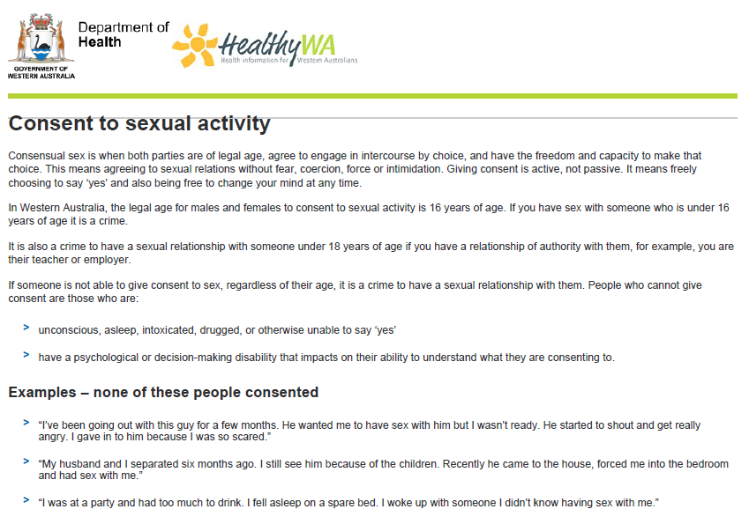
Notes:
Discuss what the Dept. of Health says regarding consent.
Image is in workbooks

Slide 12
Activity 2: Zoe and Sam (pg.34)
Zoe, aged 16
Sam, aged 17
I’ll never forget that night as long as I live. Sam and I had been going out for a while and he had always acted like a really sweet guy – well, we had done some kissing and fooling around but he never gave me any reason not to trust him.
The night of the party I wore this gorgeous dress that I borrowed from my sister. It was a bit showier than the clothes I normally wear but I thought it was very flattering.
At the party I had some beer and it made me really tired, so I wanted to lie down. Maybe I shouldn’t have suggested we both lie down together but it felt weird to just go upstairs by myself and leave Sam all alone. The next thing I know he’s all over me, forcing me to have sex with him. It was horrible. I didn’t want to scream and make a fool of myself with all those other people in the next room. I tried to fight him off, but he was too strong. Needless to say, I never want to see Sam again. He seemed like such a nice guy. What happened?
I still don’t understand what happened. Zoe and I had been seeing each other for about two months and although we hadn’t slept together yet, I had made it pretty clear that I was very attracted to her and eventually expected to have sex with her.
We were supposed to go to a party and when she showed up in this sexy low-cut dress, I thought maybe it was her way of saying she was ready.
At the party we drank some beer, which made her sort of sleepy and sensual. When she said she wanted to go lie down and wanted me to come and snuggle with her, what was I supposed to think? Of course, I thought she wanted to have sex. She did grumble a bit when I started to undress her, but I just thought she wanted to be persuaded. Lots of women feel a bit funny about being forward and they want men to take responsibility for sex. I don’t know.
We had sex and it was fine. I took her home from the party and I thought everything was ok. But ever since then she refuses to talk to me or go out with me. I thought she really liked me. What happened?
Notes:
Reflection questions on the next slide.
Story also in their books.

Slide 13
Activity 2: Zoe and Sam How does consent really work? (pg.35)
1. In that moment in the story, what could Zoe have said to Sam to express what she’s thinking and feeling to make him stop?
2. What would have stopped Zoe from speaking up? What got in the way of her expressing her feelings?
3. What non-verbal signs was Zoe giving to say she was uncomfortable?
4. What could Sam have said to Zoe to check what was going on with her?
5. What makes it difficult for Sam to say these things?

Slide 14

Activity 3: Exploring resources (pg.36)
Visit Kids Help Line and answer the questions in your workbook.
https://kidshelpline.com.au/teens/issues/what-consent
If you have time remaining, explore more aspects of the Kids Help Line website.
Notes:
Any time remaining can be spent completing this activity.
https://kidshelpline.com.au/teens/issues/what-consent

Slide 15

REFLECTION & EXIT TICKET: 3, 2, 1 RIQ
Everyone will receive a sticky note. On that sticky note answer the following:
3 x things you can RECALL (what have you learnt?)
2 x things you have found INTERESTING
1 x QUESTION you still have
Give your sticky note to your teacher on your way out.
Notes:
Resources – sticky notes
Have a look at student’s questions and try to answer them in the coming weeks.

